Slide 1

Online Hotel management System
Developed By:-
Ruparel Ruchi
Buddhdev khushbu

Slide 2
What is Online is Hotel Management System ?
Online Hotel Management System enables users to visit the website, get detailed information about the hotel by reviewing gallery and also submit their valuable feedback.
Users can be able to booked the rooms and accordingly have to pay for the same through secured payment system.
For the Convenience of Users, it also allows them to cancel the booking done by them and ensure about the refund for the same.
Notes:
How presentation will benefit audience: Adult learners are more interested in a subject if they know how or why it is important to them.
Presenter’s level of expertise in the subject: Briefly state your credentials in this area, or explain why participants should listen to you.

Slide 3
Preliminary Investigation:-
Problems Before this System
Details are enquired through phone.
It consumes more time.
Feasibility Study
Technical Feasibility
The project is working in a perfect manner.
Must support or perform all the technical functions for which it is implemented.
Economic Feasibility
Estimation of cost required for the project.
Operational Feasibility
It must implement all the operations.

Slide 4
Requirement Analysis:-
Non-Functional Requirements:-
Hardware Requirement
Processor : at least Pentium IV with 900 MHz processing speed
RAM : minimum 1GB of RAM
Hard disk : minimum 40GB of hard disk
Software Requirement
Operating System : windows, Linux, Mac OS
Browser : Google chrome, Mozilla Firefox,
Safari, Microsoft, Edge, Opera

Slide 5
Functional Requirements:-
Customers Detail
Assigning Booking
Online Booking
Online Cancellation
Payment (Bill)
Customer Feedback

Slide 6
Diagrams:-
Use Case Diagram
Class Diagram
ER Diagram
Data Flow Diagram
Activity Diagram

Slide 7
View Profile and Gallery
­­­­­
User Login
Check Room Availability
Make Booking
Cancel Booking
Make Payment
User
Feedback
Admin Login
Show Booking made by Customer
Manage and Update Database
Admin
Notes:
Example objectives
At the end of this lesson, you will be able to:
Save files to the team Web server.
Move files to different locations on the team Web server.
Share files on the team Web server.

Slide 8
Admin
username:varchar password:varchar
User
id:int name:varchar address:varchar city:varchar mbno:varchar email:varchar user:varchar password:varchar compass:varchar
Feedback
id:int name:varchar email:varchar comment:varchar
Onlinecancel
id:int uid:int rooms:varchar price:int nofro:int chkin:date chkout:date
Onlinebooking
id:int uid:int rooms:varchar price:int nofro:int chkin:date chkout:date
Payment
chn:varchar card_no:int cvv_no:int

Slide 9
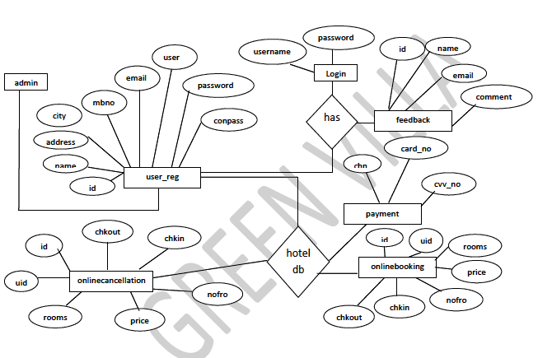
Admin
user_reg
hoteldb

Slide 10
Zero level diagram:-
Customer Management
Booking Management
Hotel Management
User Management
Login Management

Slide 11
One-Level Diagram:-
Customer Booking
User
Invoice
Data base
Hotel
Feedback
Admin
Manage and Update Database

Slide 12
Start
Registration
New
Online Booking
Login
Validations
yes
No
Invoice
Cancellation
Validations
yes
Payment
Booking Successfull
No
Stop

Slide 13
Test Data Preparation:-
Test Case: 1
Test Name: userregistration
Purpose: Ensure that users can register themselves.
Action | Test Data | Expected Result | Actual Result | Pass or fail
User Registration | Already Registered Email/user/mbno | Error message | Error message | Pass
 | Invalid name/address/city/mbno/email/user/password | Error message | Error message | Pass
 | Incorrect re-enter password | Error message | Error message | Pass
 | Correct name/address/city/mbno/email/user/password/conpass | Redirecting page | Redirecting page | Pass

Slide 14
Test Case: 2
Test Name: onlinebooking
Purpose: Ensure that users can done onlinebooking of rooms.
Action | Test Data | Expected Result | Actual Result | Pass or fail
onlinebooking | Invalid nofro/chkin/chkout | Error message | Error message | Pass
 | Correct nofro/chkin/chkout | Redirecting page | Redirecting page | Pass

Slide 15
Test Case: 3 Test Name: payment Purpose: Ensure that payment made by users for booking done by them.
Action | Test Data | Expected Result | Actual Result | Pass or fail
Payment | Invalid chn/card_no/cvv_no | Error message | Error message | Pass
 | Correct chn/card_no/cvv_no | Redirecting page | Redirecting page | Pass

Slide 16
Test Case: 4 Test Name: feedback Purpose: Enabling users to give feedback.
Action | Test Data | Expected Result | Actual Result | Pass or fail
Feedback | Invalid name/email/comment | Error message | Error message | Pass
 | Correct name/email/comment | Redirecting page | Redirecting page | Pass

Slide 17
Thank You……

